Slide 1
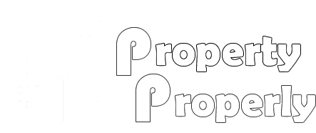
Group Name: disFunction()
Group Members: Tahir Leonard & David Schwartz
Application link: https://agile-ravine-72792.herokuapp.com/

Slide 2
Main Goal:
Improve communications between tenants and managers to create detailed analytics regarding time from tenant maintenance request to request completion.
Create a property management application that allows property managers to track maintenance men, time/cost of each maintenance job done and tenant and manager work/cleanliness rating.
Secondary Goal:
Rental Property Maintenance Tracking
Tenant Maintenance Request
Tenant Work Rating
Tenant Cleanliness Rating

Slide 3
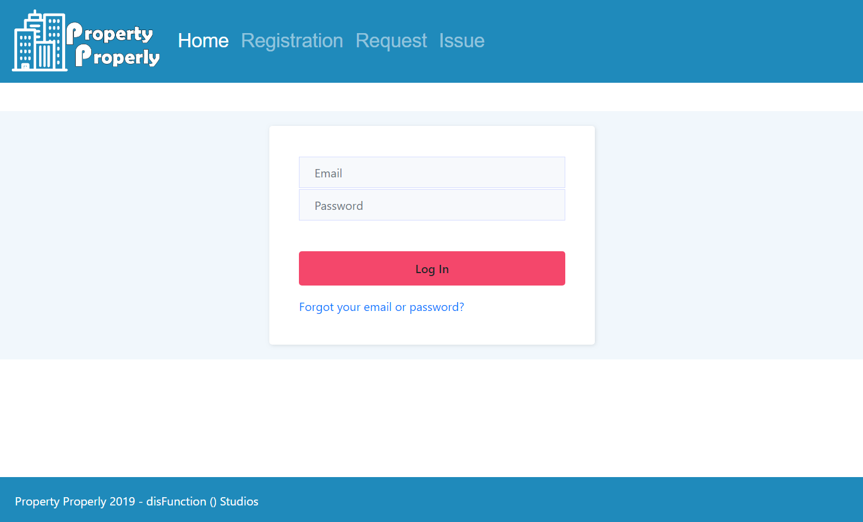
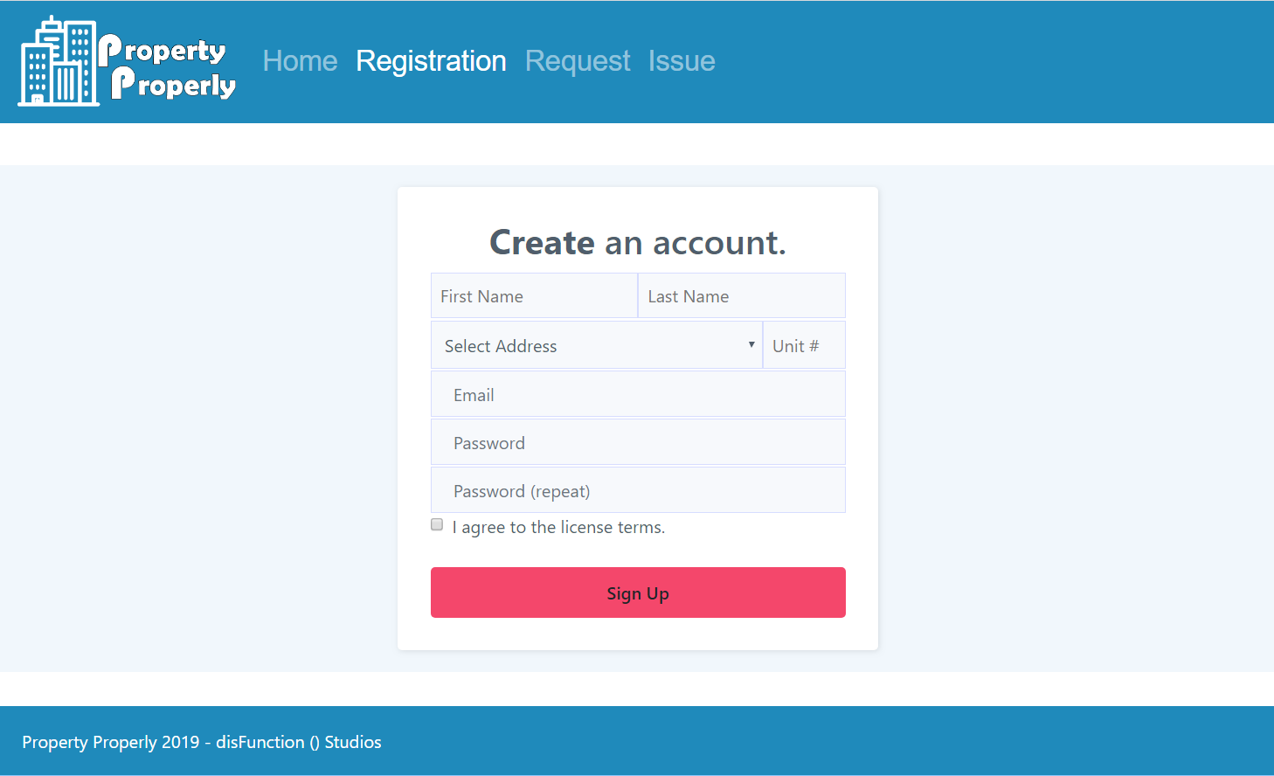
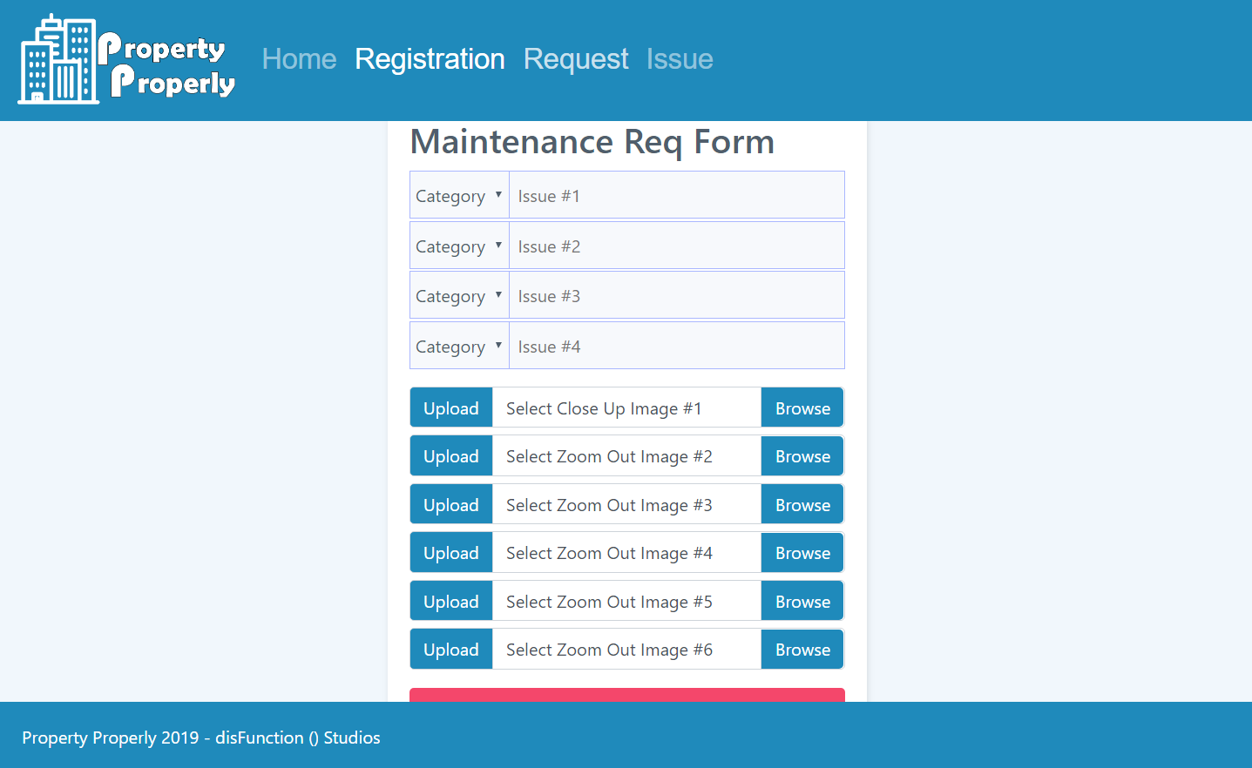
Stage 1 (MVP): Login, Account Creation, Maintenance Request Form, Maintenance issue update page.
Stage 2: Create page for Supervisors/Owners to see work/cleanliness of each maintenance man and track timeliness 0f maintenance requests from initial request time to request completion time

Slide 4
Stage 3:
Beacon tracking system to identify when maintenance is being done and track time more precisely for each job.
Stage 4:
Add prospect rental application

Slide 5
Front End Technologies
React
React-Dom
React-Scripts
React-Dev-Utils
React-Router-Dom

Slide 6
Iceboxed Features for the Frontend
Manager Updates
Manager work Rating
Manager Cleanliness Rating
Completion date
Work order number
Maintenance man

Slide 7
Backend
Technologies Used On The Backend
Mysql2
Express
Sequelize
Sequelize-cli
Axios
Body-parser
Chalk
Cloudinary
Dotenv
Express-generator
Morgan

Slide 8
Database:
We used Mysql2 because we needed a database that would provide complex relationships between tables.
We needed to be able to generate relational queries between the different tables for both reporting and to help us scale the application in the future by compartmentalizing our data.

Slide 9
Tables That We Created Were
Users
User_types – to define access for particular routes and queries
Requests
Status_categories – to define request status from a dropdown
Issues
Issue_categories
Locations

Slide 10
The new Technologies that we used:
CHALK – Ability to have log messages on the server show different colors – i.e. “success” or “error”
CLOUDINARY – an NPM package for storing images into a cloud account for when tenants and maintenance workers take pictures of the issues, both before and after the work request was complete.
This was to provide accountability for the maintenance works and to ensure the quality of the work was up to par upon completion.

Slide 11
ICEBOXED:
Login authenticaton and authentication on each page of the application
Getting the Cloudinary portion of the application to work correct and upload/download photos with a reference in the database
Showing complete reports for maintenance request such as time from start to completion or maintenance worker ratings
Accepting applications from new tenants

